Slide 1
CORONAVIRUS (COVID-19)
Vaccine Passport

Slide 2
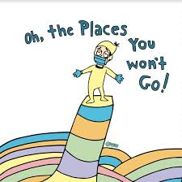
Many people have been staying at home to avoid getting sick
from the coronavirus or spreading germs to others.
This means many places in the community were closed and there were strict rules I had to follow at home.

Slide 3
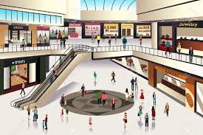
Over the past several months, a lot of work has gone
into making the community safe.
Places in the community are now open
and people are spending more time outside of their homes.
.

Slide 4
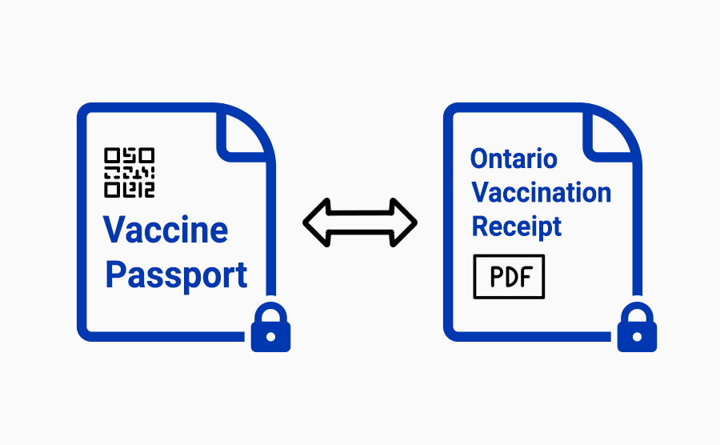
To keep everyone safe, the government of Ontario has created a new system called the vaccine passport system.
Just like other rules I already follow at home and in the community, I will need to follow this new set of rules as well.

Slide 5
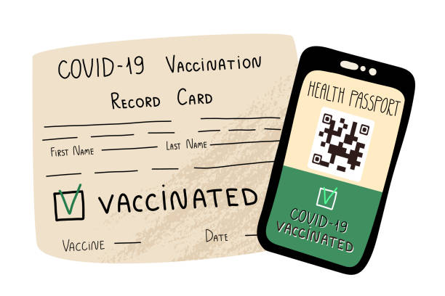
A vaccine passport includes a receipt to show that I have been vaccinated with 2 doses of a Covid vaccine at least 2 weeks ago.
This can be printed on a piece of paper or downloaded on a phone.

Slide 6
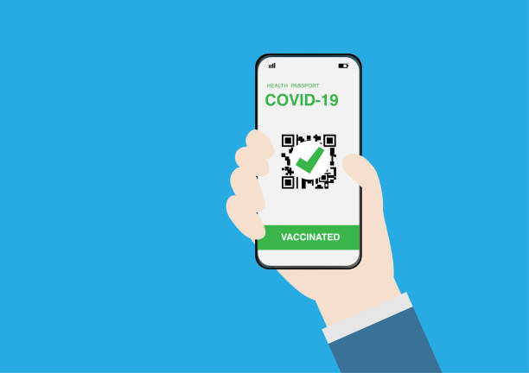
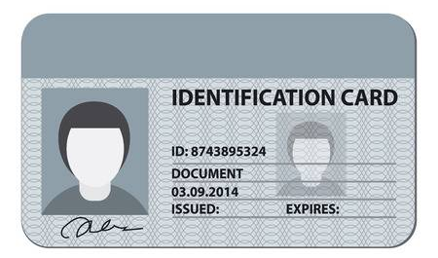
When I visit certain places in the community, I will need to show:
A vaccine receipt, and
My ID (Exp. birth certificate, passport, health card, etc.)

Slide 7
I WILL need to show my vaccine passport ( vaccine receipt + ID ) when I visit the following places:
Indoor areas of restaurants and bars
Indoor areas of concerts, theatres, cinemas, casinos and bingo halls
Indoor areas of sport and recreation centers (exp. Gyms, swimming pools, sport venues, etc.)
Indoor areas of meeting and event places (exp. Banquet hall, convention center, etc.)

Slide 8
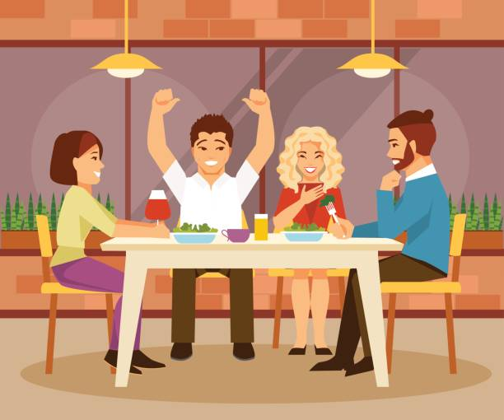
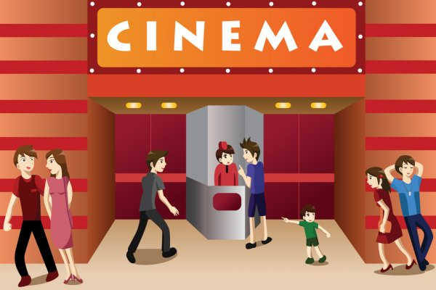
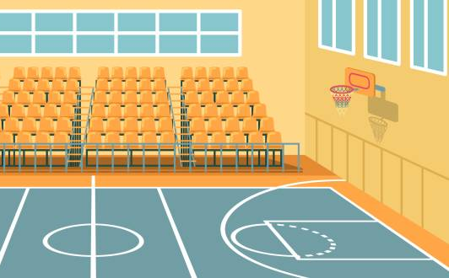
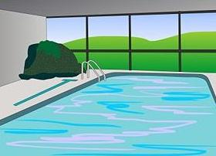
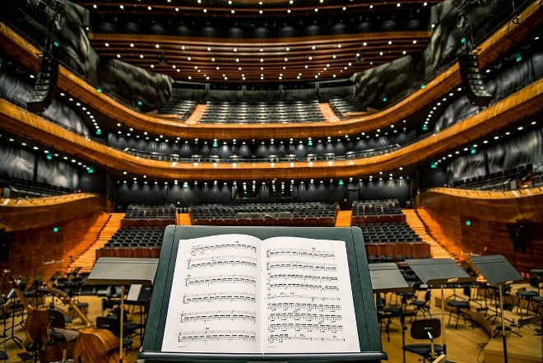
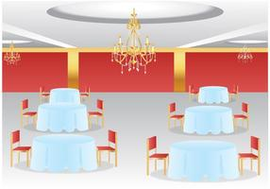
Vaccine passport: YES
Indoor Restaurant/Coffee Shop
Cinema/Movie Theatre
Sport Venue
Indoor Swimming Pool/Gym
Indoor Concert/Theatre
Banquet Hall/Convention Centre

Slide 9
When I go to these places, I can expect someone will ask to see my vaccine passport (vaccine receipt + ID).
They will also ask me questions about Covid or have me fill out a piece of paper.
I will show them my vaccine passport and answer the questions.
After I do so, I will be allowed to enter the place.
If I don’t show my vaccine passport or answer the questions, I will not be allowed to enter the place.

Slide 10
For some places or situations a vaccine passport is NOT needed.
I WILL NOT need to show my vaccine passport:
When I am in an outdoor gathering or space
If I enter an indoor space to get takeout, go to the washroom, or to make a purchase
To attend a wedding ceremony or funeral service
To visit an essential place (exp. Medical office, hospital, hair salon, grocery store and mall)

Slide 11
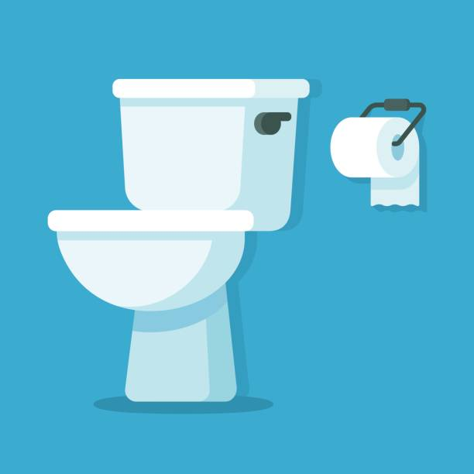
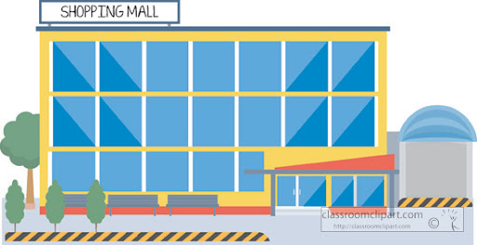
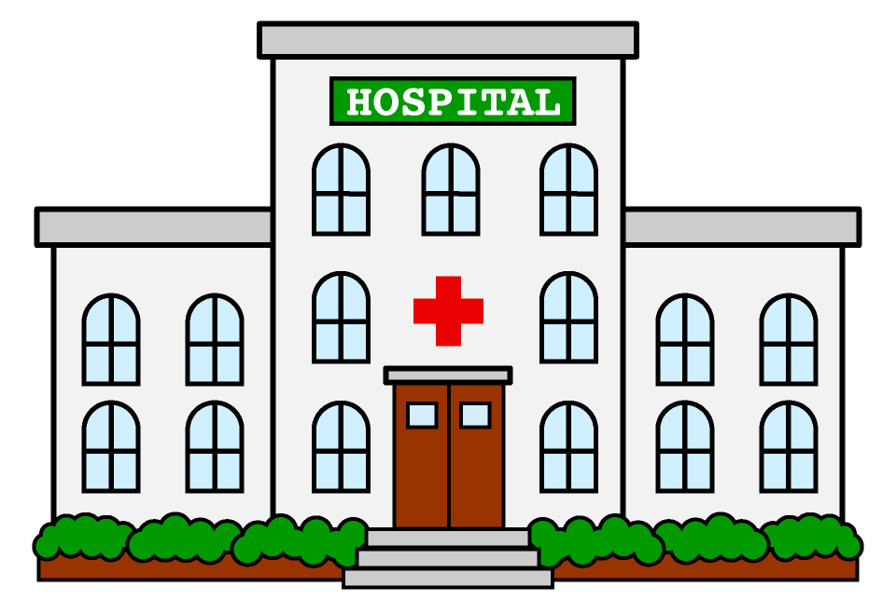
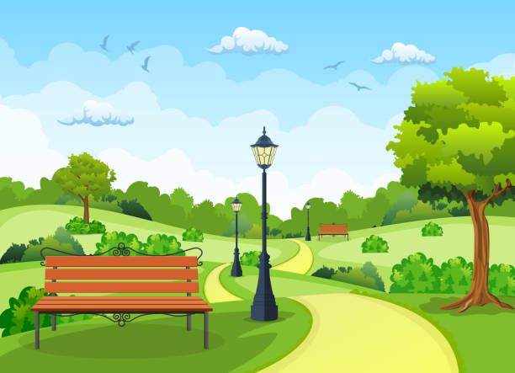
Vaccine passport: NO
Public Washroom
Takeout Food or Coffee
Shopping Mall/Grocery Store
Hospital/Medical Office
Outdoor Gatherings/Spaces
Hair Salon/Personal Care Services

Slide 12
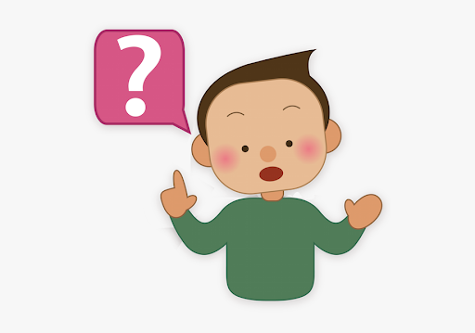
If I am unsure whether or not the place I am going to needs me to show my vaccine passport, I can ask my staff or family.

Slide 13
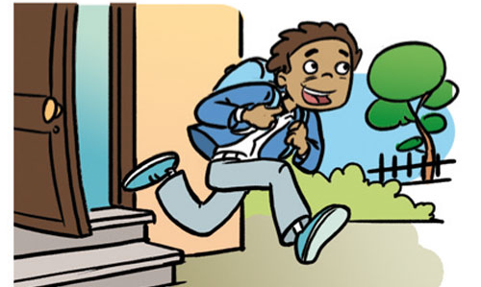
It is important that when I leave the house I have the right documentation with me.
My staff or family can support me to put together the documentation I need for the vaccine passport system.

Slide 14
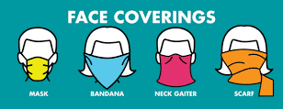
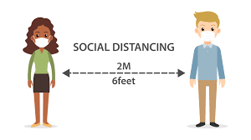
It is also important that I always follow all heath and safety precautions
when I visit places in the community.
This includes:
Wearing a mask or face covering
Cleaning my hands often with soap and water
or hand-sanitizer
Keeping 2 meters/6 feet distance from others
Staying home if I am feeling sick

Slide 15
Learning that about the vaccine passport might make me feel different emotions.
It is okay to feel this way.

Slide 16
I have people in my life who are here to support me.
If I have questions or need support I can talk to them.

