Slide 1
CORONAVIRUS (COVID-19)
COVID Vaccine Booster (Third Dose)

Slide 2
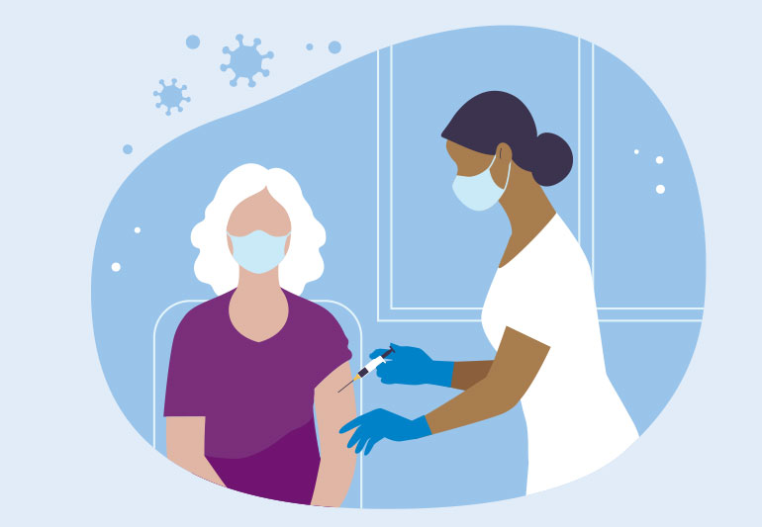
Over the past year people everywhere have been getting the
COVID vaccine to protect themselves and others from getting sick.

Slide 3
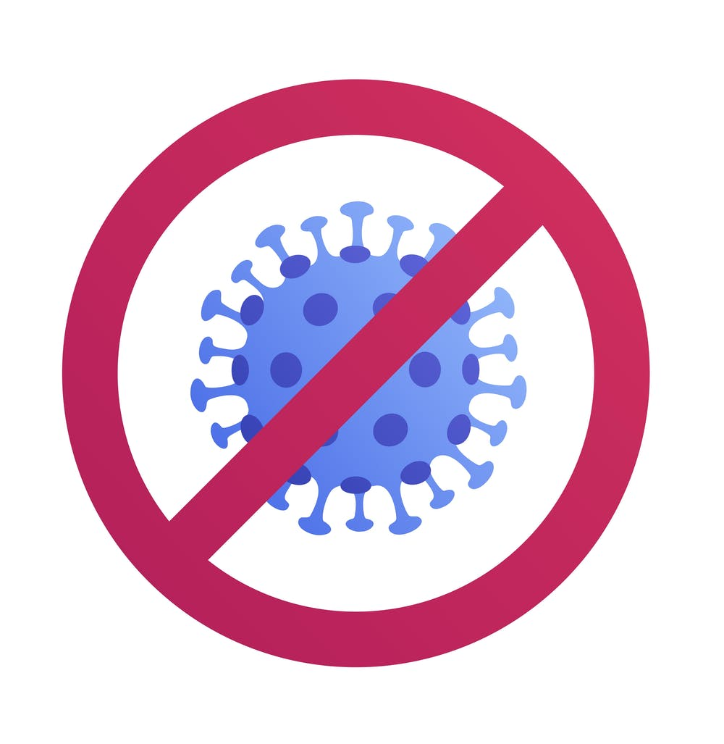
We know that the COVID vaccine is safe and that it works.
It helps prevent serious sickness, having to go to the hospital,
and the spread of COVID.

Slide 4
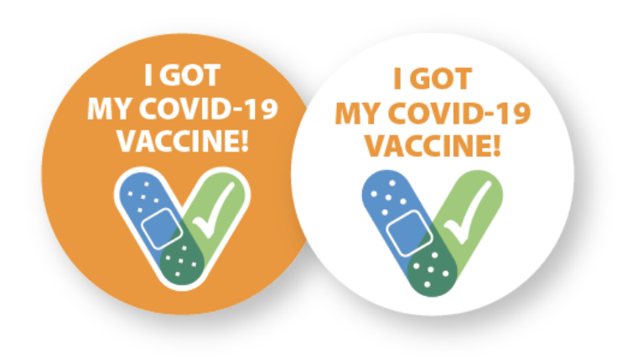
This past year, I have gotten 2 doses of the COVID vaccine.
This means that for awhile I was protected from getting really sick or going to hospital because of COVID.

Slide 5
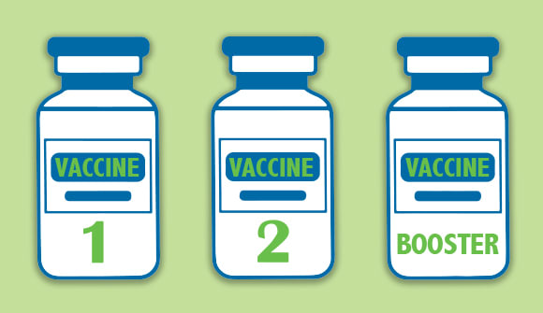
Recently, doctors and the government have said that certain groups of people should get a COVID vaccine booster to keep them safe.
A vaccine booster is a third dose (or shot) of the COVID vaccine.

Slide 6
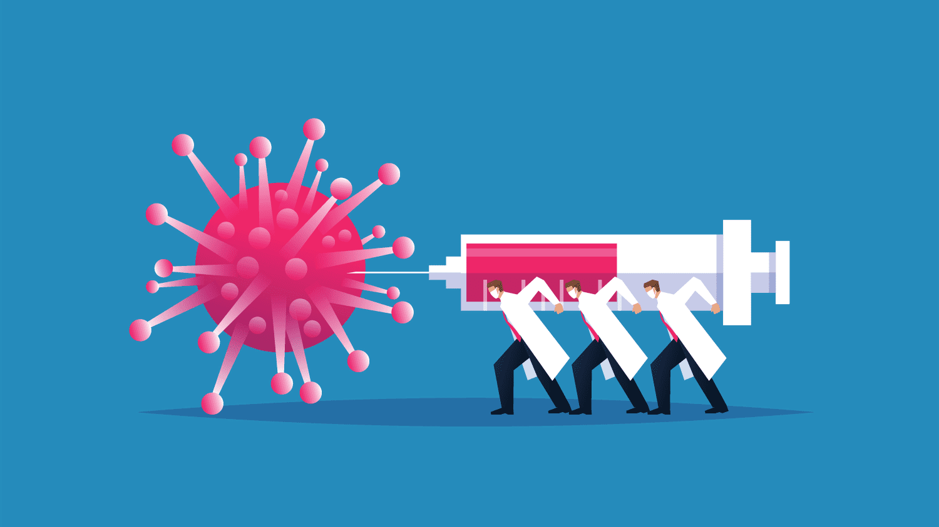
A COVID vaccine booster helps because we know:
COVID is still spreading and making people sick
Protection from the COVID vaccine does not last forever,
it wears off
The winter months are coming and people get more sick from COVID in the winter months

Slide 7
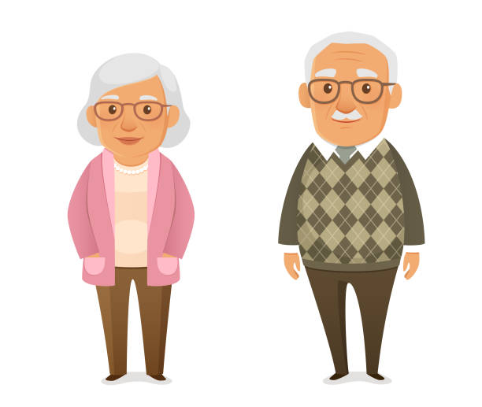
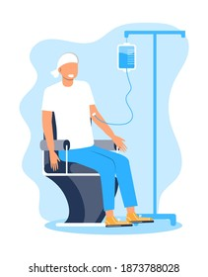
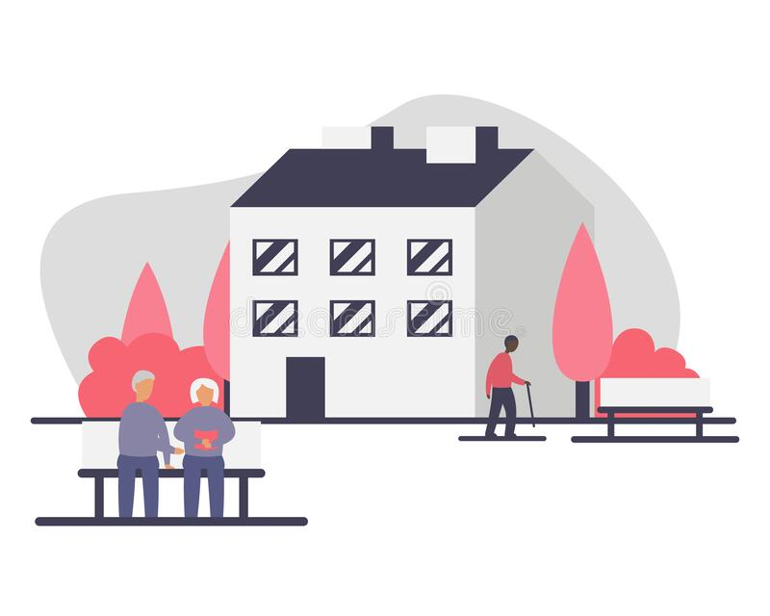
Right now, the COVID vaccine booster (third dose) is for people who are at higher risk of becoming sick from COVID.
This may be because of their older age, health conditions
or because of where they live (Exp. A group home).

Slide 8
I am able to get the COVID vaccine booster – my third dose of the vaccine.

Slide 9
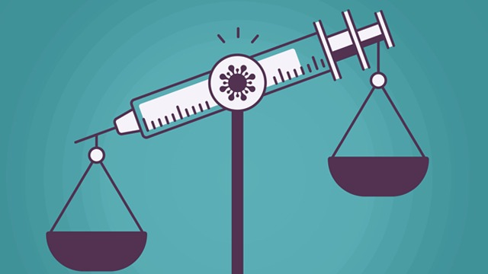
It is really important that I get the COVID vaccine booster
– my third dose of the vaccine.
But it is also really important that I know the risks and benefits
of getting the COVID vaccine booster, so that I can make an informed decision.

Slide 10
Benefits of the COVID vaccine booster include:
Keeping me from getting very sick from COVID
Keeping me from needing to go to the hospital
Keeping my family, friends, staff and housemates safe
Helping to reduce the spread of COVID

Slide 11
Risks of getting the COVID vaccine booster include:
Arm soreness where I get the shot
Feeling unwell for a few days after the shot
Needing to go to the hospital if I have a bad reaction to the shot
Becoming sick from COVID even though I had the vaccine booster
Knowing that the COVID vaccine booster is new and that most people have not had 3 doses yet.

Slide 12
After knowing about the risks and benefits of the COVID vaccine booster,
I will then need to give my consent to get the third does of the vaccine.
If I am unsure or have more questions, I can talk to my doctor.

Slide 13
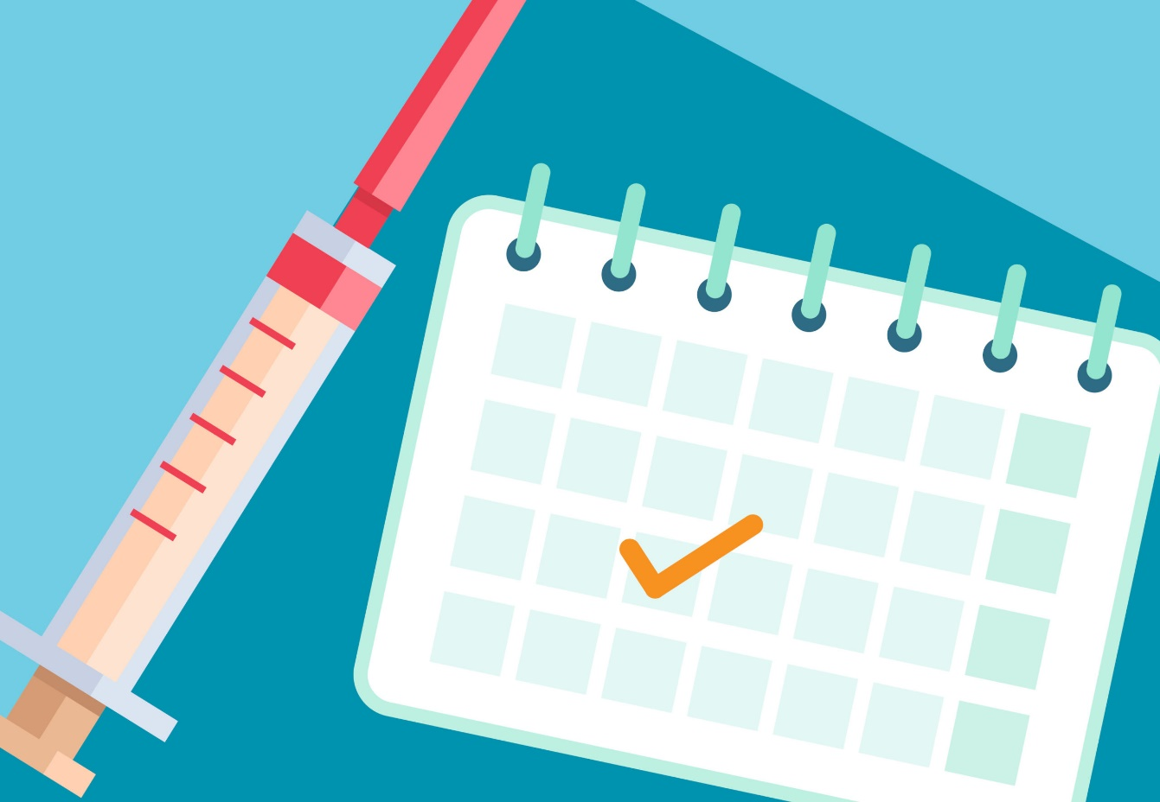
To get my third does of the COVD vaccine,
I will need to book an appointment at a vaccine clinic
My staff or family can support me with this.

Slide 14
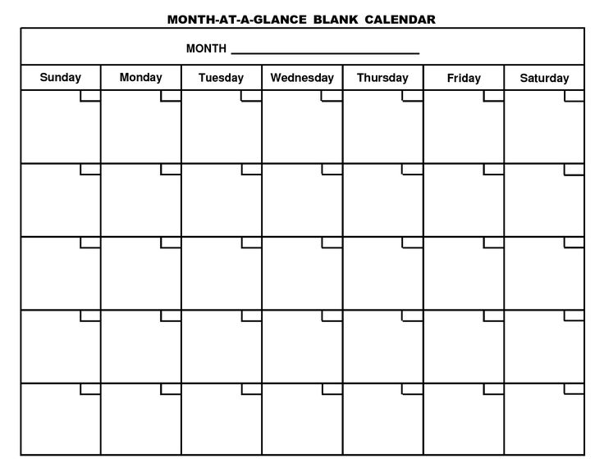
My third dose of the COVID vaccine will be on this date: _________________________ .

Slide 15
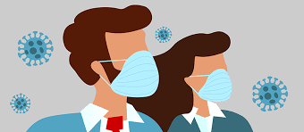
After I am vaccinated with my third dose, I will still need to follow all the COVID rules to keep myself and the people around me safe.

Slide 16
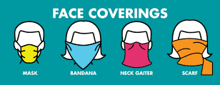
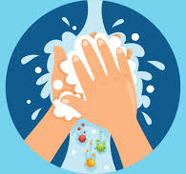
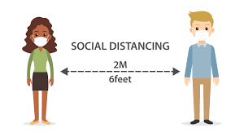
This includes:
Wearing a mask or face covering
Cleaning my hands often with soap and water
or hand-sanitizer
Keeping 2 meters/6 feet distance from others
Staying home if I am feeling sick

Slide 17
Learning about the COVID vaccine booster,
might make me feel different emotions.
It is okay to feel this way.

Slide 18
I have people in my life who are here to support me.
If I have questions or need support I can talk to them.

